Slide 1

Engineering Graphics
INT 109 P
Sections of Solids
Dr. Vikash Kumar

Slide 2
Introduction
Section plane
Interior hollow portions are represented by dashed lines.
When the interior is complex , these dashed lines are numerous (Drawing is difficult to interpret).
To overcome this difficulty, it is imagined that object is being cut through completely or partially by plane called cutting or ‘’section plane’’.
Cut surface of the object
Represented
Section lines inclined at 45°

Slide 3
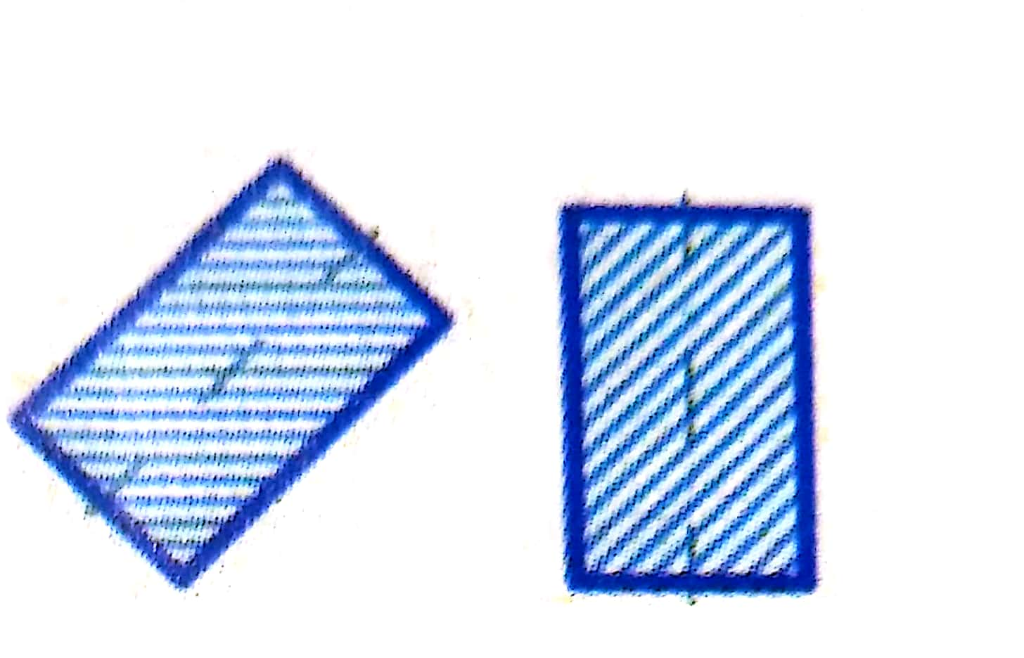
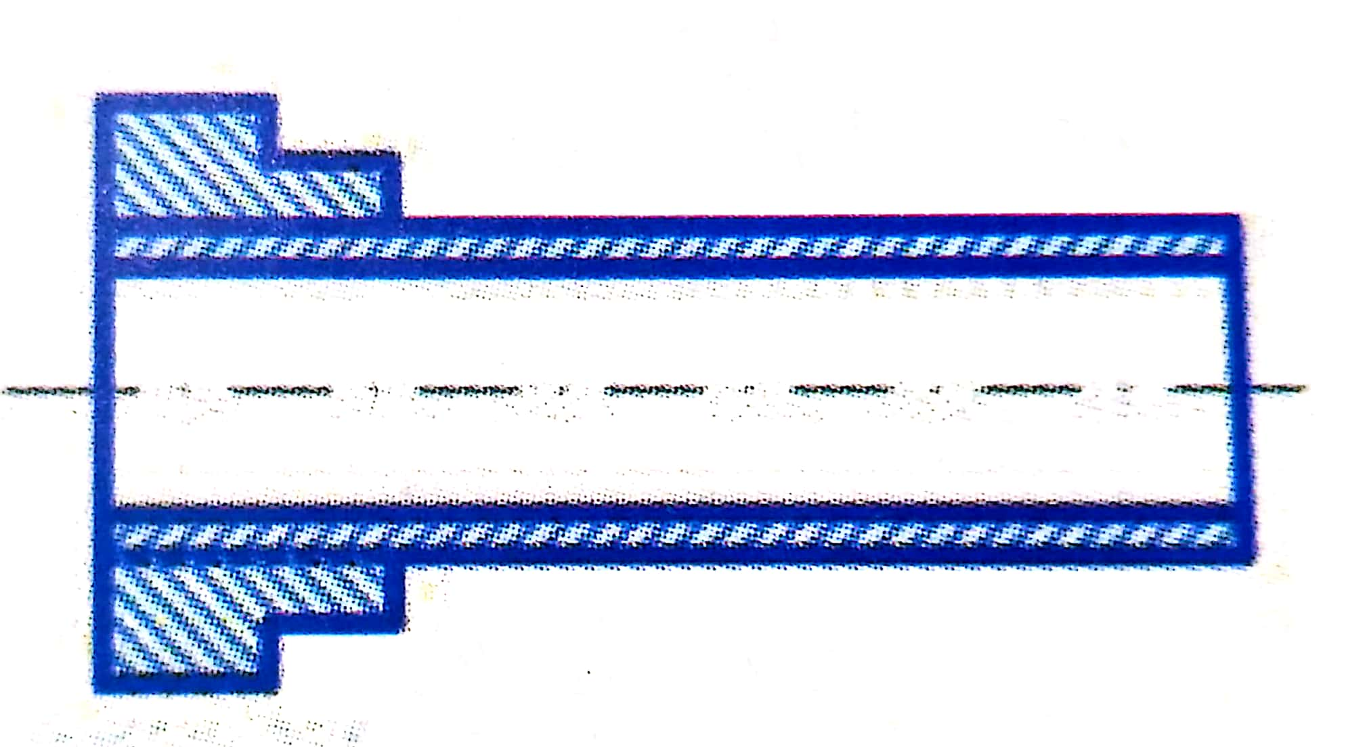
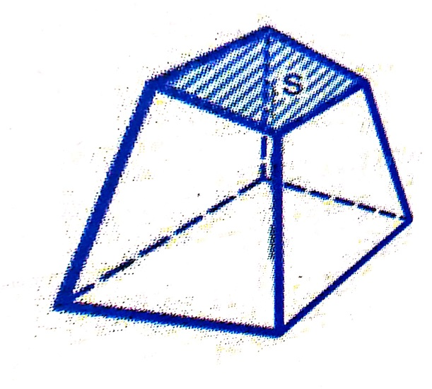
Hatching
The process of drawing section lines is called Hatching
Spacing of lines
Should not be less than 0.7 mm
Continuous narrow lines
Different direction for hatching
Hatching Interruption to place inscriptions

Slide 4
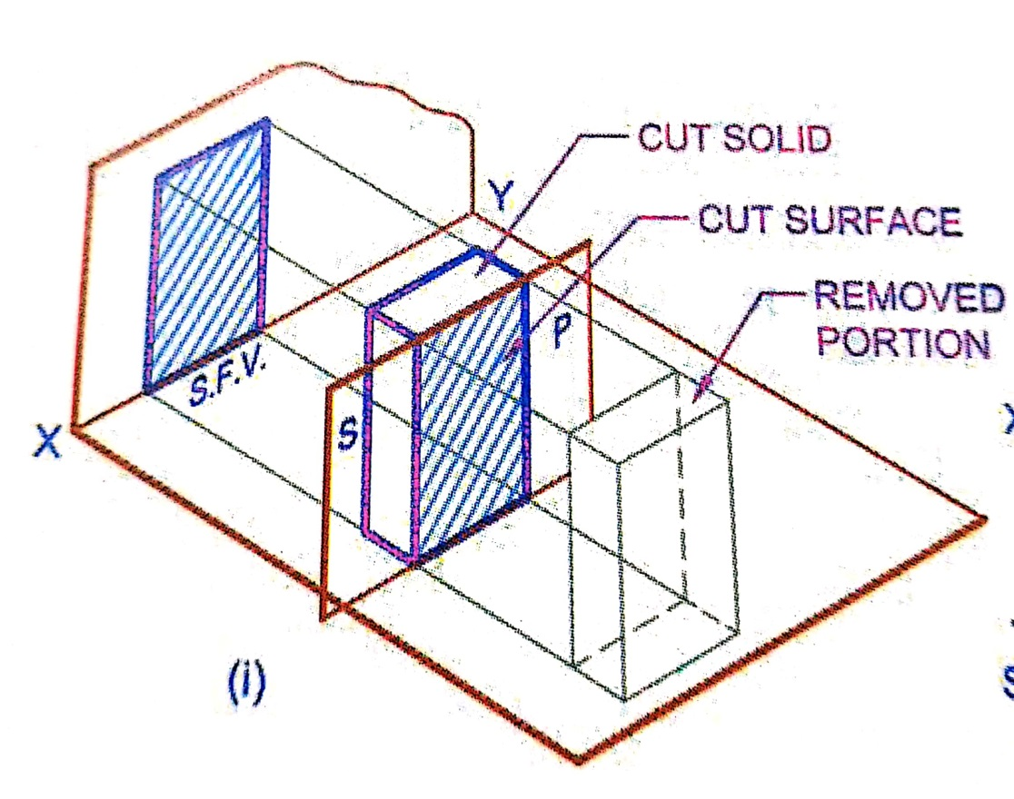
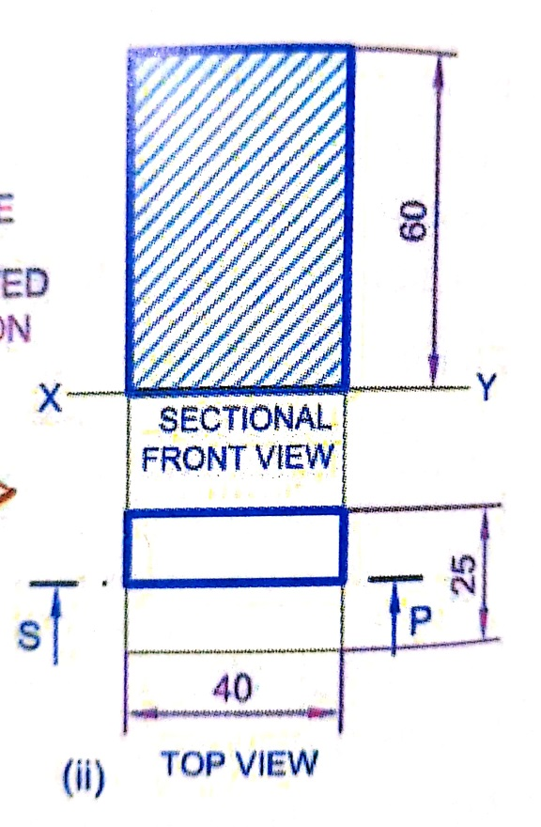
Section plane Parallel to one plane
A rectangular prism, side of base 40 mm X 25 mm and height 60 mm , rests with its base on HP such that one of its larger rectangular faces is parallel to VP. A section plane perpendicular to HP and parallel to VP cuts the prism into two equal halves. Draw its top view and sectional front view.
Pictorial view

Slide 5
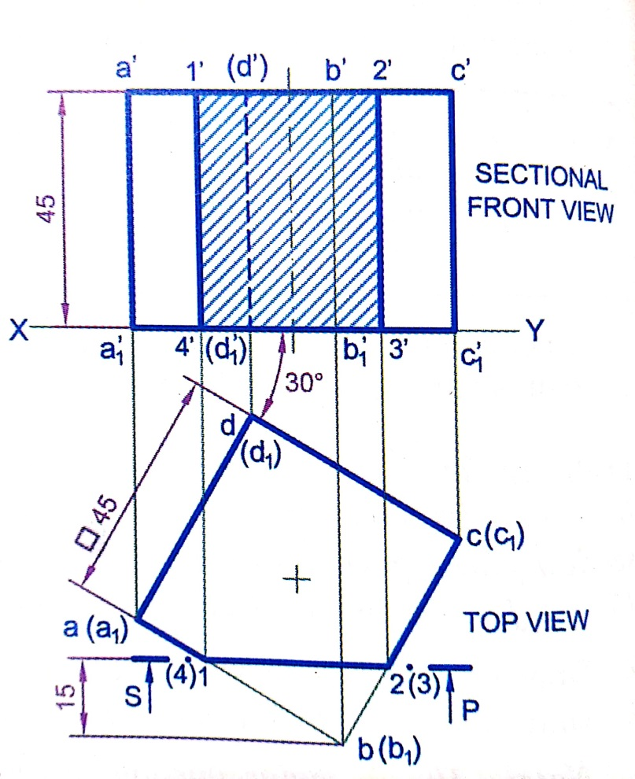
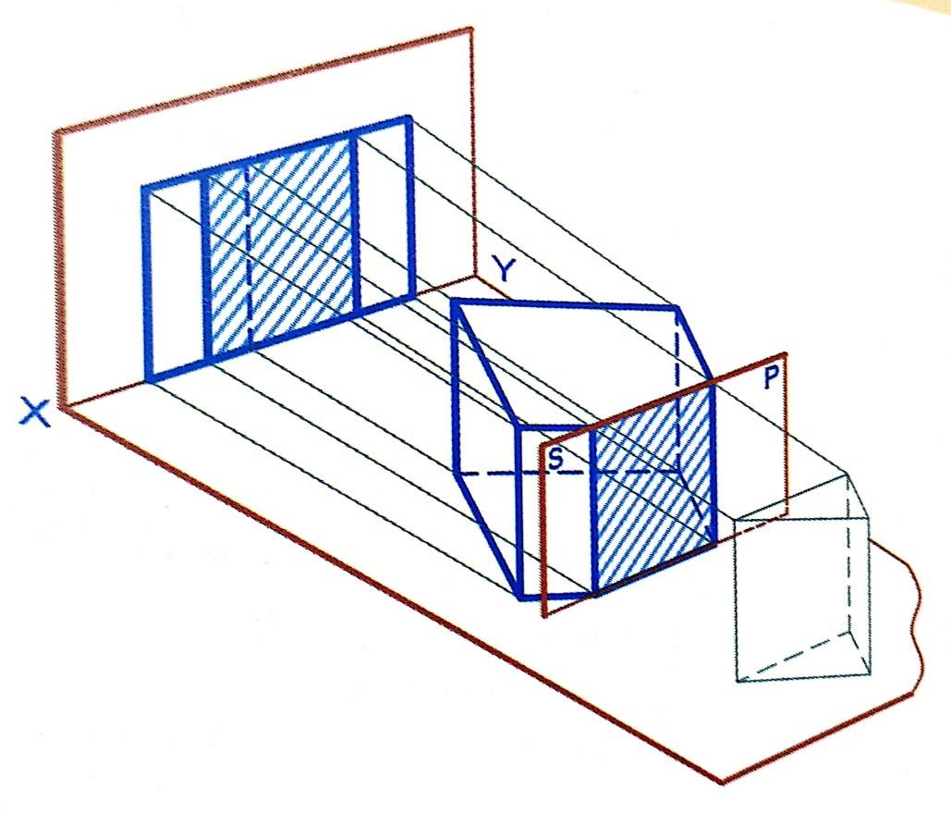
Section plane Parallel one plane
A cube of 45 mm side rest with a face on HP, such that one of its vertical faces is inclined at 30° to VP. A section plane, parallel to VP cuts the cube at a distance of 15 mm from the vertical edge nearer to the observer. Draw is top and sectional front views.
Pictorial view

Slide 6
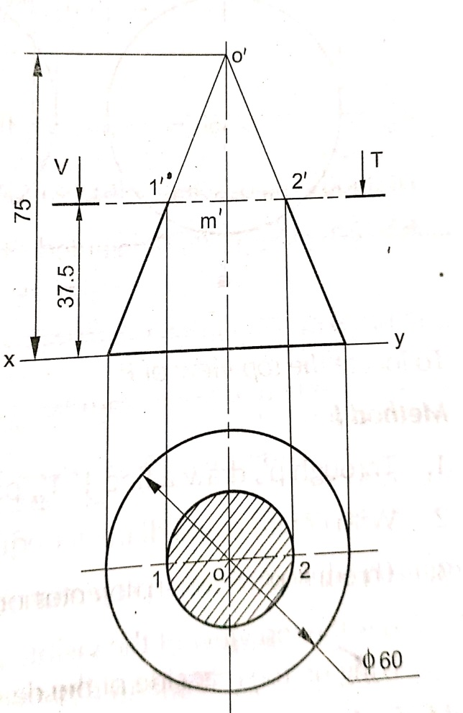
Section plane Parallel one plane
A cone with base 60 mm diameter and 75 mm long axis, is resting on its base on HP. It is cut by a section plane parallel to HP and passing through the mid-point of axis. Draw the projection of cut solid.

Slide 7
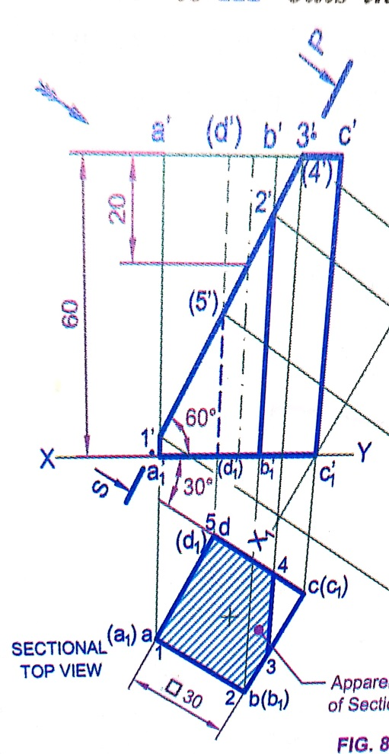
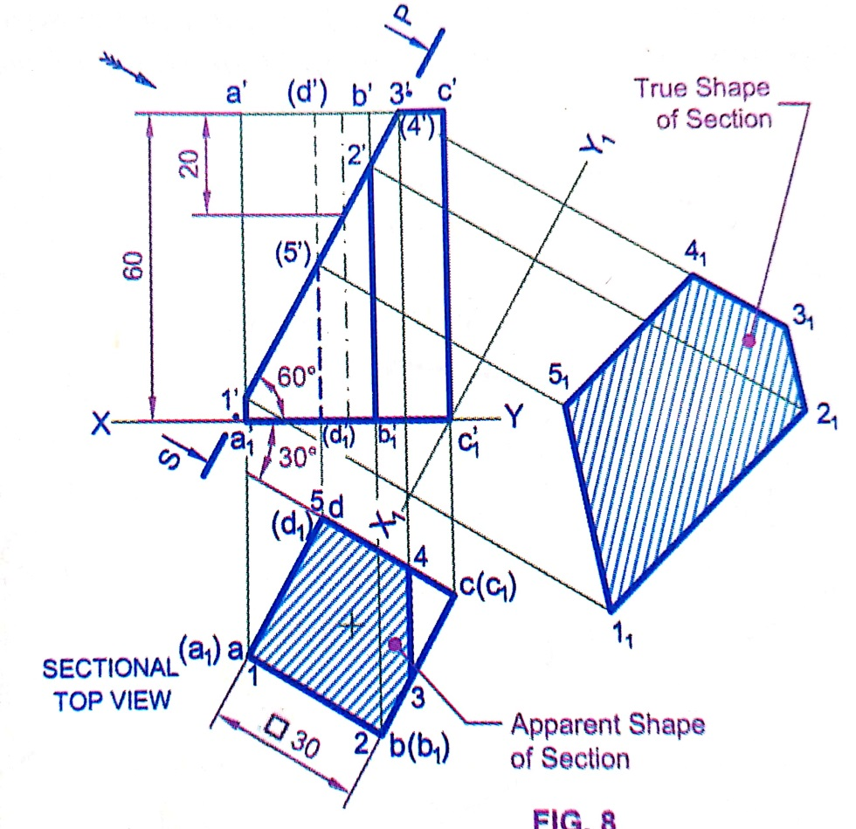
Section plane inclined to one plane
A square prism, side of base 30 mm and axis 60 mm long, rests with its base on HP and one of its rectangular faces is inclined at 30° to VP. A section plane perpendicular to VP and inclined at 60° to HP cuts the axis of the prism at a point 20 mm from its top end. Draw section top view and true shape of section
Apparent shape of section

Slide 8
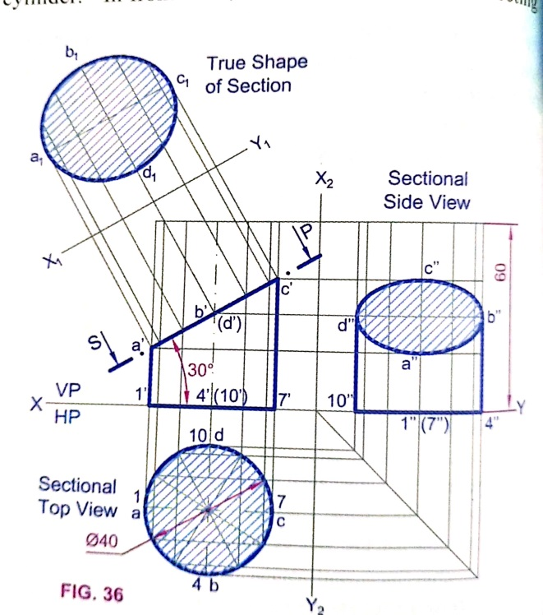

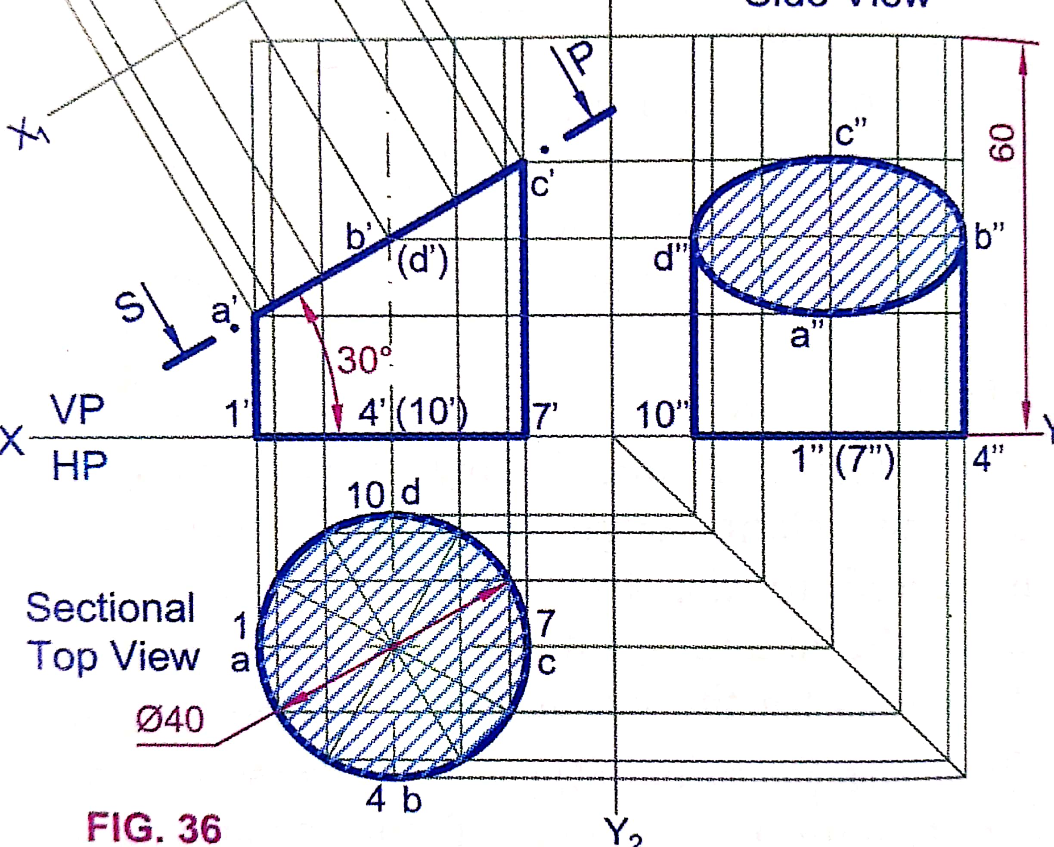
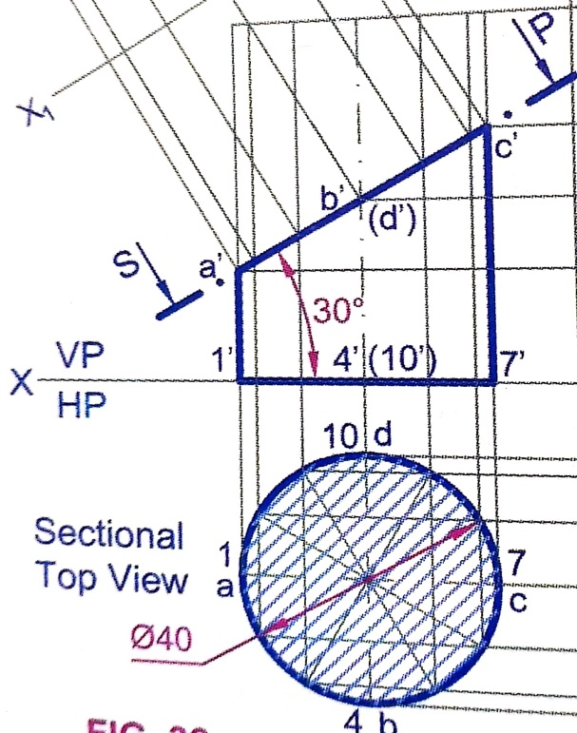
Section plane inclined to one plane
A cylinder of diameter 40 mm and height 60 mm is having its axis vertical. It is cut by a plane perpendicular to VP and inclined at 30° to HP. The plane bisects the axis of cylinder. Draw its front view, sectional top view, sectional view and true shape of section.

Slide 9
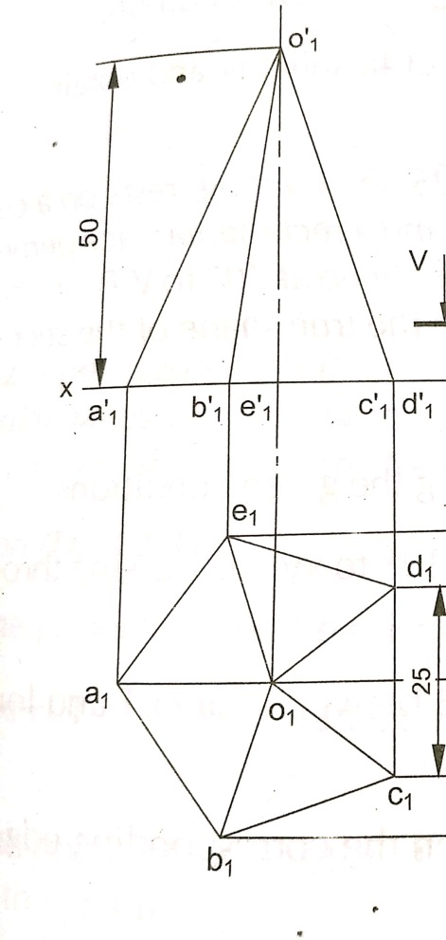
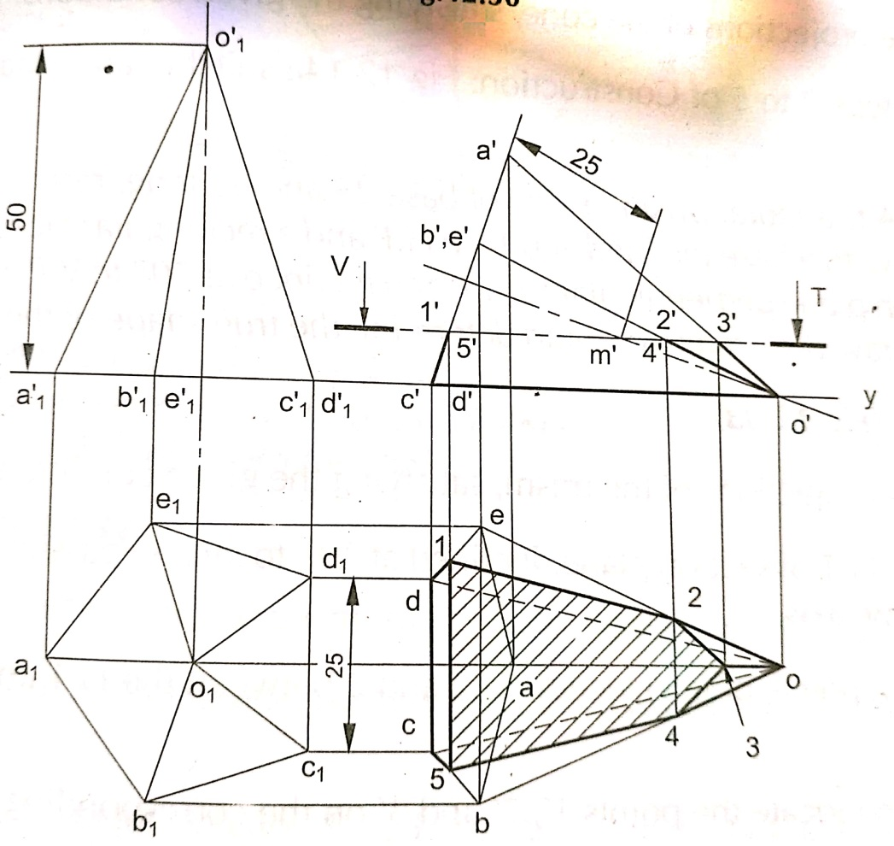
A pentagonal pyramid of side of base 25 mm and 50 mm height, rests on a traingular face on HP, with its axis parallel to VP. It is cut by a horizontal section plane, bisecting the axis. Draw the projection of retained solid.

Slide 10


Typical section places and shape of sections
Triangle
Section Plane
Through Generators
Ellipse
Section Plane
Through Apex
Parabola
Section Plane Parallel
to end generator.
Section Plane
Parallel to Axis.
Hyperbola
Ellipse
Trapezium
Cylinder through
generators.
Sq. Pyramid through
all slant edges

Slide 11
Thank You

